Slide 1



The Future of
Regtech
Revolutionizing Identity Verification and Regulatory Compliance

Slide 2




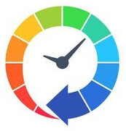
Problem Statement
Financial fraud and cybercrime costS businesses over $500 billion annually!
Over $3 trillion in illicit funds flowed through the global financial system in 2023!
Over 90% of global banks and 85% of mid-sized financial institutions are still relying on outdated, manual processes!
Current compliance methods are costly, time-consuming and are error prone!

Slide 3


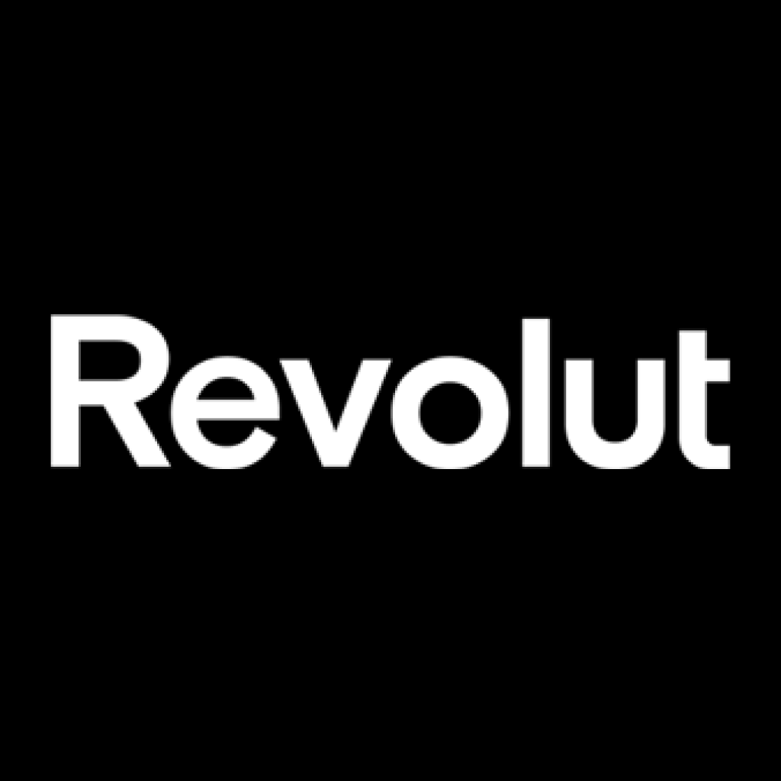





Need / Demand
Companies fined for regulatory & compliance breaches - 2023
$2.9M
5.3M
Euros
10M
Pounds
$600M
1.5M
Euros
$4.5M
$8.6M
The 2020 Wirecard collapse, involved €1.9 billion in missing funds, revealed large-scale fraud that went undetected due to weak compliance and manual oversight.

Slide 4
NorthRow Bridging the Gap -
Solution
Know Your Business (KYB)
Know Your Customer (KYC)
Digital Identity Verification
Ongoing Customer Monitoring
Customer Remediation
Supplier Due Diligence
Anti-Money Laundering (AML) Compliance
Right to Work verification

Slide 5

Growth Strategy
AI-Driven Automation
Strategic Client Expansion and
Market Penetration
Products
Enhance Compliance Accuracy
Predictive Insights
Proactive Risk Management
Operational Excellence
Streamline Process
Cost Reduction
Operational Optimization
Full-time headcount to be decreased
Address overstaffing
Nearshore & Offshore Resource engagement models
Target different geographies
Take Northrow Global – Expanding to new untapped markets – Driving growth
Focus on maximizing TCV

Slide 6
Market Opportunity
Total Addressable Market:
$21 Billion
Compliance costs for financial institutions are set to exceed $210 billion, as businesses struggle to keep pace with constantly evolving regulations
With over 80% of financial institutions poised to ramp up AI spending on compliance in the next five years, the market is ready for Northrow’s AI-powered solutions to revolutionize the landscape.
Total Addressable Market
$21 Billion
Compliance Costs for Financial Institutions
$210 Billion

Slide 7
Competitive Advantage
AI Powered - End to End Product Offering – Faster – Reliable – Cost Effective
__________________________
Freedom – Data agnostic
__________________________
Extensive Experience - Existing customers – Fortune 500 + Top Tier Banks
__________________________
Integratable architecture
NorthRow
Competitors

Slide 8



Pricing
Standard
Premium
Standard
15,000£
35,000£
65,000£
per year
per year
per year

Slide 9

Financials
Current Revenue
£3M in revenue
Revenue Projections
10X through global expansion
Tapping into SAM from SOM
Growth Projections

Slide 10
Team
Umar Qadri
Umar Qadri
Umar Qadri
Functions
Designation
20 years of experience
Functions
Designation
20 years of experience
Functions
Designation
20 years of experience

Slide 11

Roadmap / Use of Funds
Product Development
Advanced AI-Powered Fraud Detection and Prediction Capabilities
Scalable, Modular AI Solutions
Explainable AI (XAI) for Compliance Transparency
AI-Driven Personalization and Adaptive Learning
Proactive Compliance Monitoring and Alerts
Integration with Existing Systems
Data Privacy and Security Through AI
Continuous Learning and Evolution of AI Models

Slide 12

Roadmap / Use of Funds
AI-Powered Customer Onboarding and Verification
Organizational
Development
Human-AI Collaboration Tools

Slide 13
Join us in revolutionizing the future of regulatory compliance.
Thank You!

